Slide 1
ONERA-6 Problem

Slide 2
Drag Coefficient

Slide 3
Cluster Range
Cluster 1 0.0196 – 0.0250
Cluster 2 0.0036 – 0.0098
Cluster 3 0.0146 – 0.0194
Cluster 4 0.0257 – 0.0455
Cluster 5 0.0099 – 0.0144

Slide 4
Size of Clusters
Cluster 1 75
Cluster 2 33
Cluster 3 83
Cluster 4 34
Cluster 5 72

Slide 5
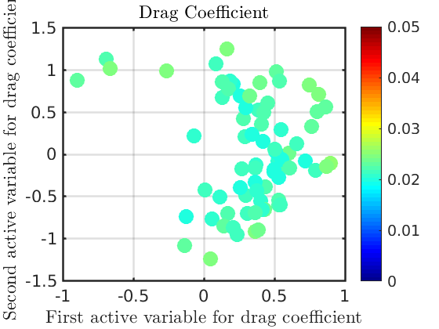
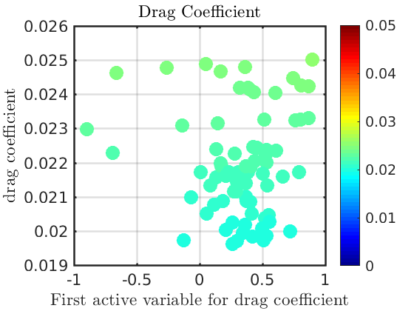
Cluster 1

Slide 6
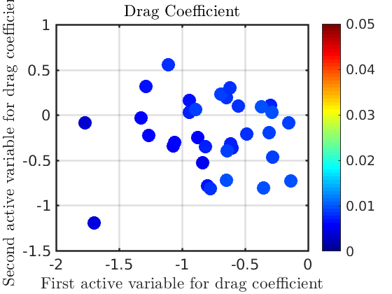
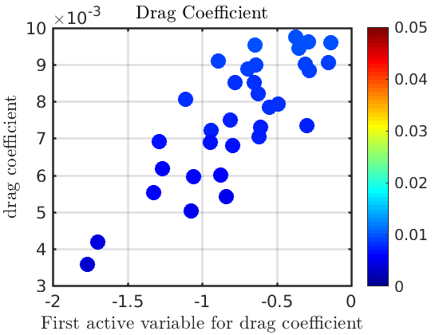
Cluster 2

Slide 7
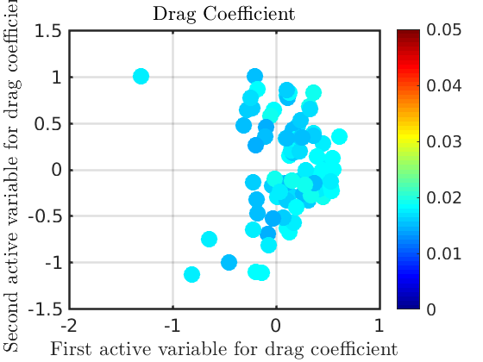
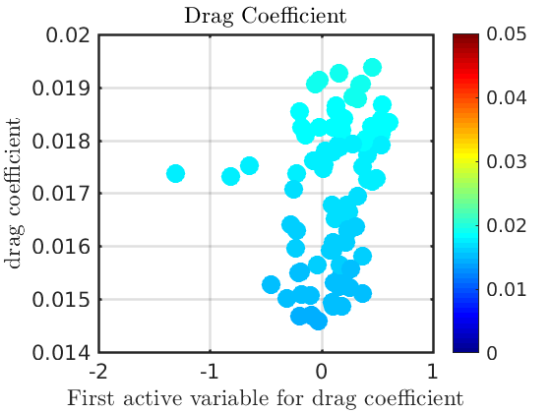
Cluster 3

Slide 8
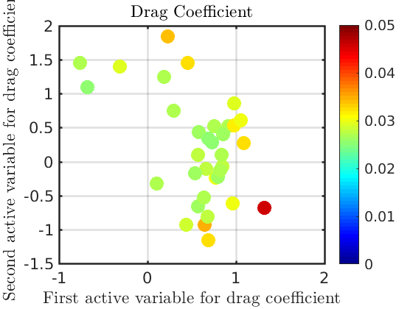
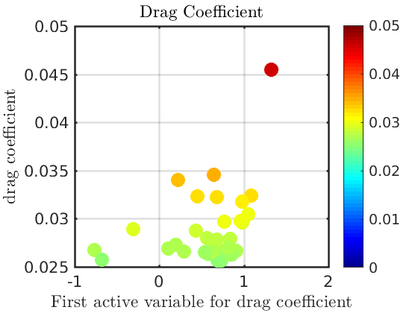
Cluster 4

Slide 9
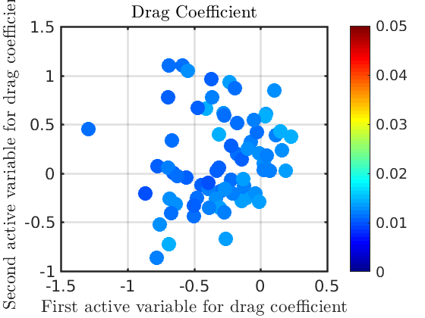
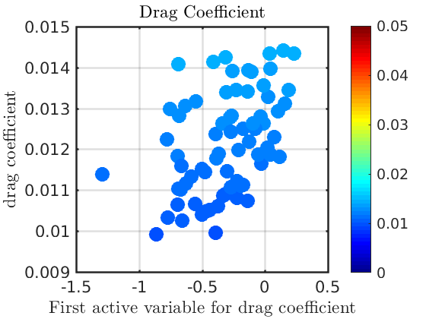
Cluster 5

Slide 10
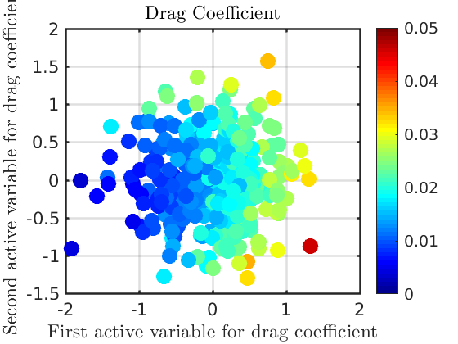
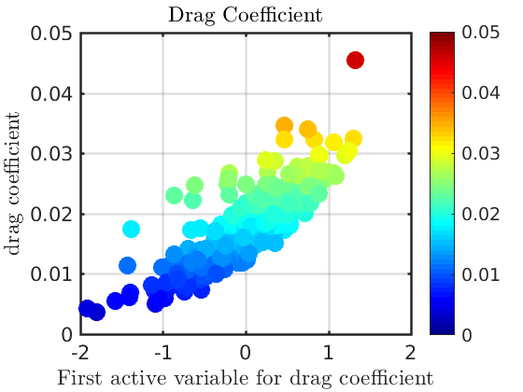
Global Results

Slide 11
Distances of First Eigenvector
Cluster 1 0.0502
Cluster 2 0.1711
Cluster 3 0.1310
Cluster 4 0.2259
Cluster 5 0.3049

Slide 12
Lift Coefficient

Slide 13
Cluster Range
Cluster 1 0.1979 – 0.2605
Cluster 2 0.3652 – 0.5026
Cluster 3 0.1038 – 0.1943
Cluster 4 0.3097 – 0.3628
Cluster 5 0.2617 – 0.3091

Slide 14
Size of Clusters
Cluster 1 75
Cluster 2 46
Cluster 3 40
Cluster 4 66
Cluster 5 70

Slide 15
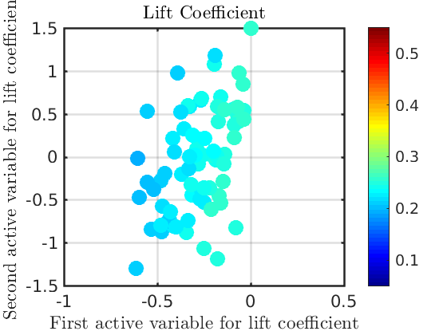
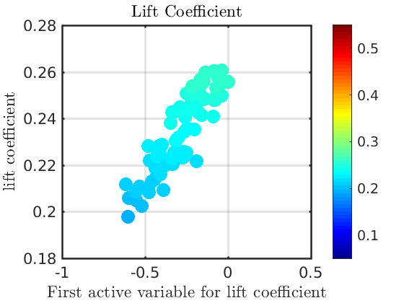
Cluster 1

Slide 16
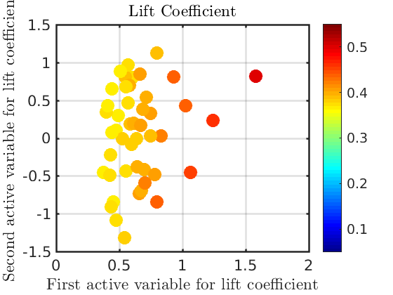
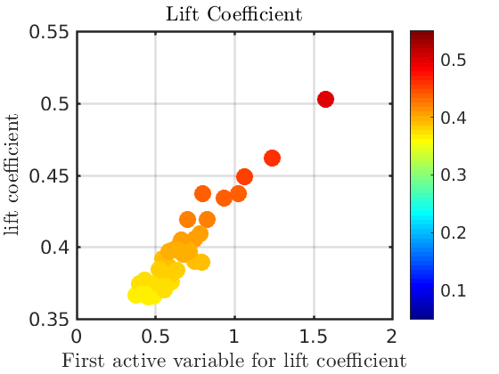
Cluster 2

Slide 17
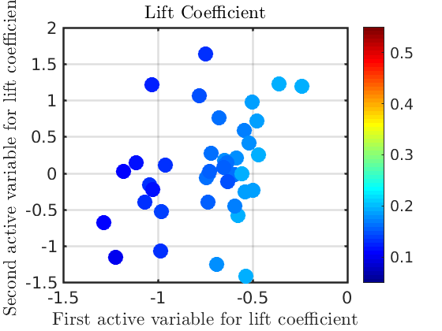
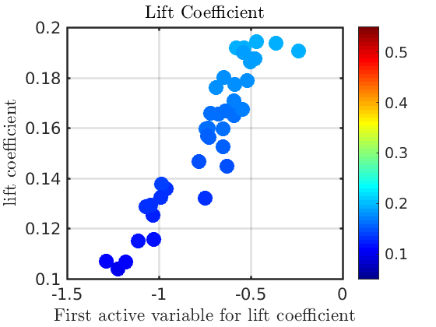
Cluster 3

Slide 18
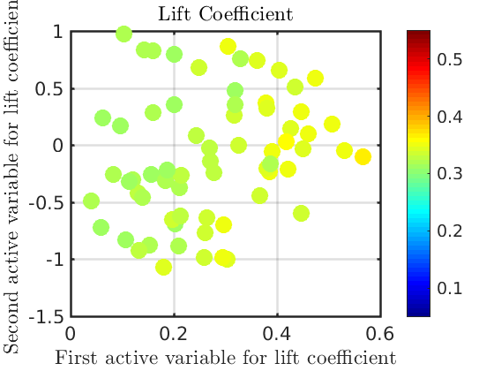
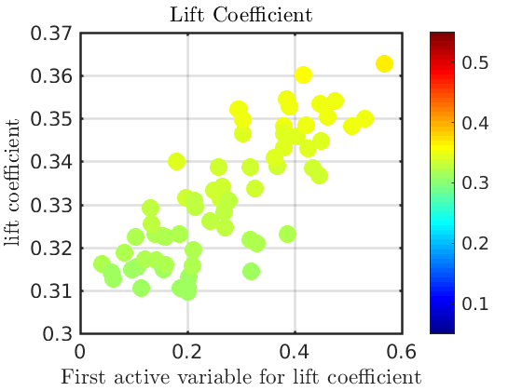
Cluster 4

Slide 19
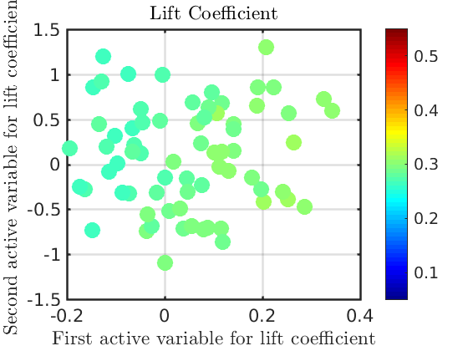
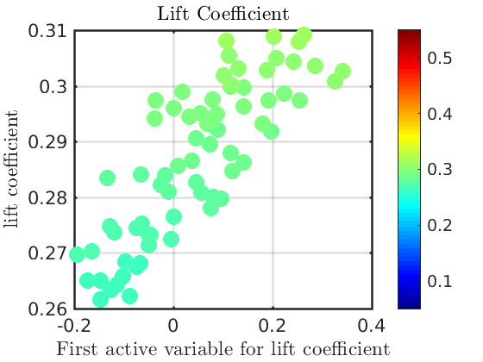
Cluster 5

Slide 20
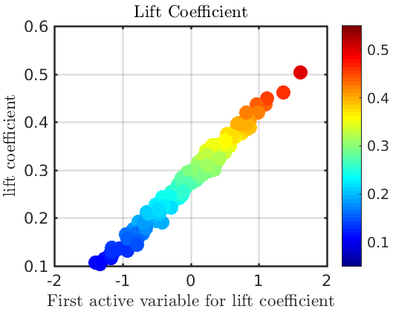
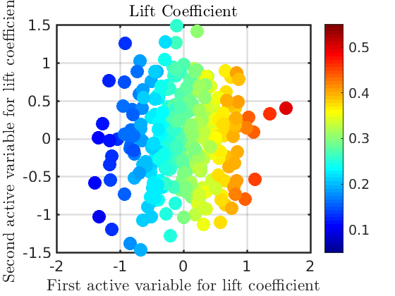
Global Results

Slide 21
Distances of First Eigenvector
Cluster 1 0.0285
Cluster 2 0.0463
Cluster 3 0.0562
Cluster 4 0.0244
Cluster 5 0.0109

